Slide 1
PhishMon: A Machine Learning Framework for Detecting Phishing Webpages
BY: Austin Willoughby, Jorge Vargas Amezcua, and John Tomaselli

Slide 2

The Basics of Phishing Attempts
What Does Phishmon Do?
Their (Author’s) Findings
Our Situation
Provided Data
Our Findings
Questions

Slide 3

The basics of phishing attempts
Phishing Engineering
Bypass email filters
Gather sensitive data
Get unauthorized access
Methods of Phishing
Email’s with malicious links
Webpages with malicious URL’s
Masquerade webpages as legitimate (Code Complexity)
Using certificates or external validation of credibility (Certificate Features)

Slide 4

What does PHISHMON do?
The author claims:
Not exclusive to Windows, macOS, etc
Not guaranteed to be full proof
Language agnostic
Targets intrinsic features
HTTP Features - Does URL vary from expected norms?
Code Complexity - How intricate is the employed code?
Certificate Features - Are the features associated with webpage’s certificate?
Phishmon is a, “scalable feature-rich machine learning framework for detecting unseen phishing attacks in a real-time fashion.”

Slide 5
Our situation
Our Goal: Using data provided by the lead researcher, we wished to validate the results achieved in the Phishmon paper using mentioned machine learning techniques.
Machine learning algorithms:
Classification and Regression Tree (CART)
Random Forest
K Nearest Neighbors (KNN)
Adaptive Boosting (ADABoost)
Platform / Tools Used: Python (Sci-Kit Learn / Pandas).
Notes:
Austin

Slide 6

Data
Variables describing website/email properties
Initial:
24232 entries
14 variables (including tag of phish/not).
Additional Data:
Later provided with data containing corresponding certificate features over 7 variables.
This data not yet used in our models
Notes:
Austin

Slide 7
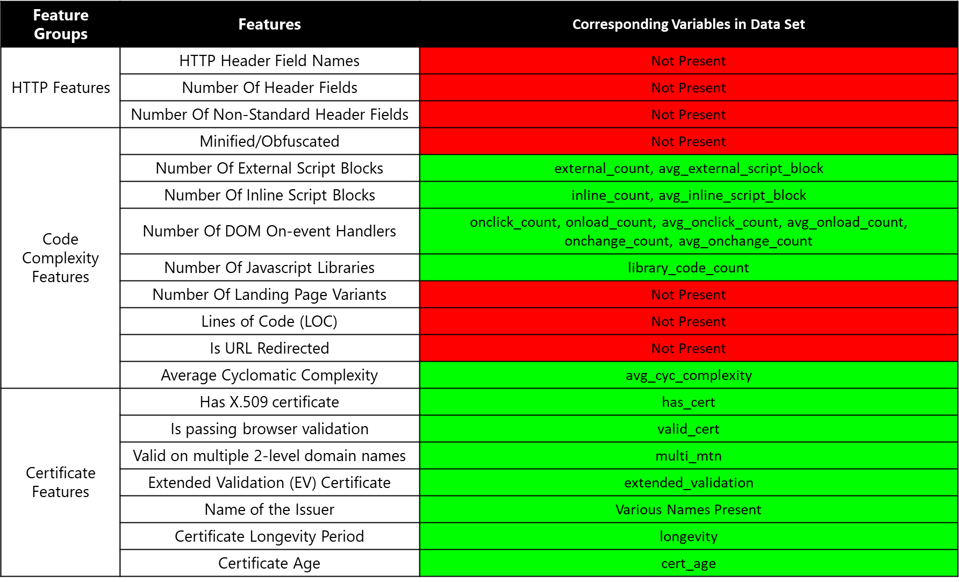
Provided data

Slide 8
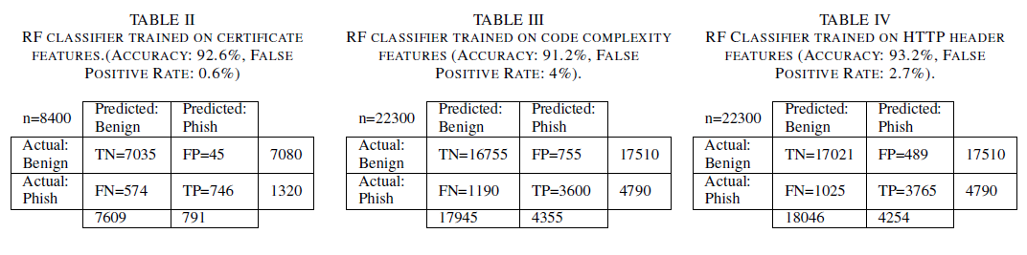
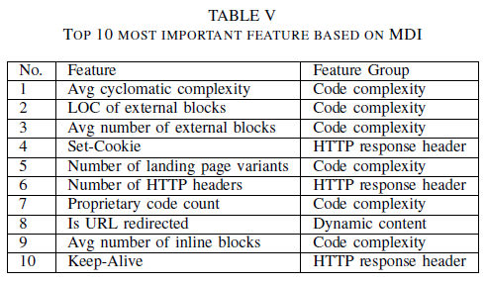
Their findings

Slide 9
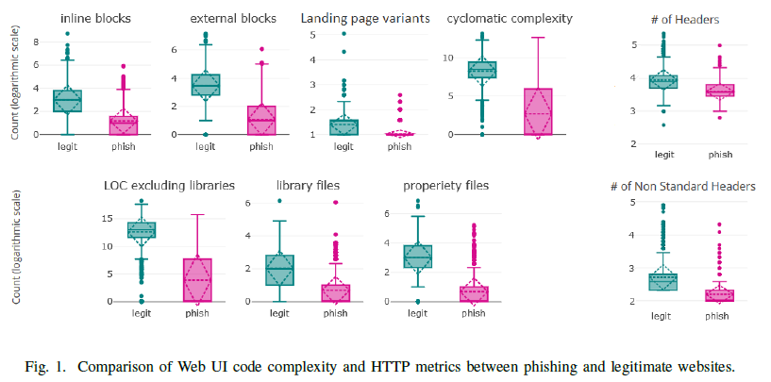
Their findings

Slide 10
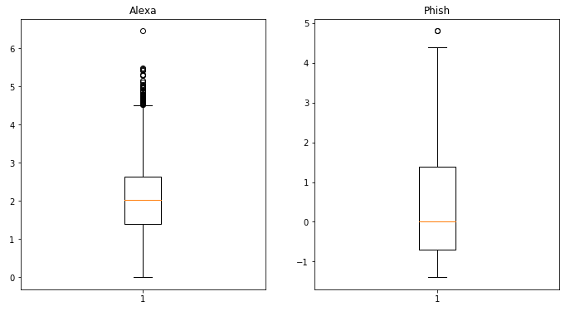
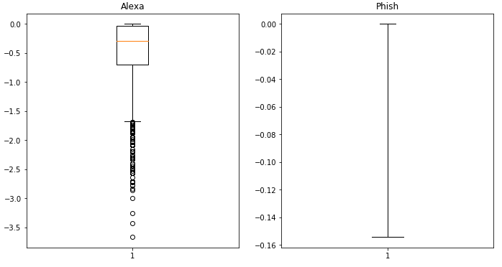
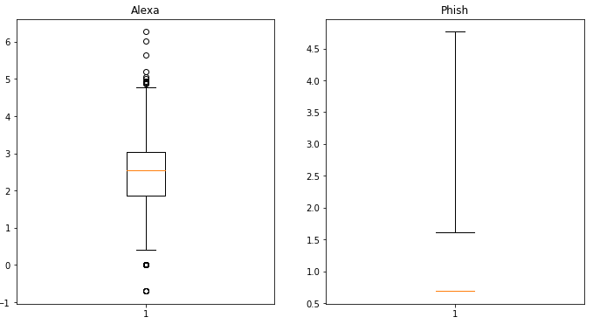
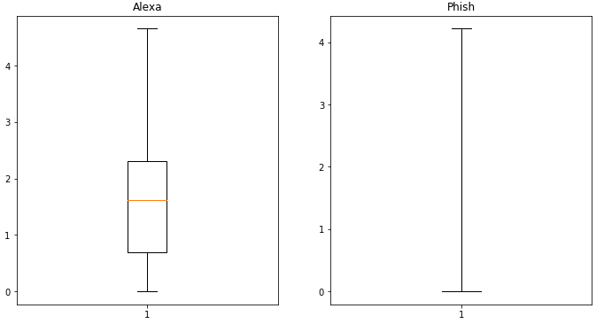
Our Findings: Generally
Inline Block Count
Cyclomatic Complexity
External Block Count
Library Lines of Code

Slide 11
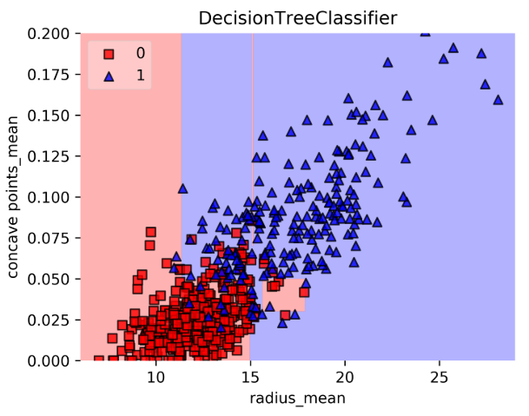
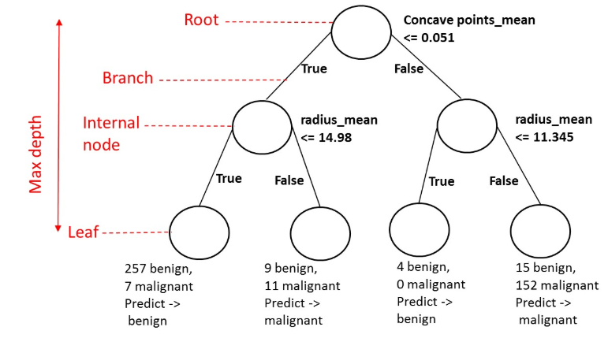
CART (Classification And Regression Trees)
Used for situations where regression isn’t feasible
Fewest leaves possible produced at each node by maximizing information gain

Slide 12
Our findings: CART
Variables Tested | Our Response Fit
All Variables Provided (Some Missing) | 88.03%
Average Cyclomatic Complexity | 83.16%
Average Number of External Blocks | 72.47%
Proprietary Code Count | 83.20%
Average Number of Inline Blocks | 80.09%
Number of DOM On-Event Handlers | 86.91%
Notes:
Austin
Include visualization of CART and Random Forest before each results section

Slide 13

Random Forests
Similar to CART, but with many trees
Trained from a bootstrap sample (i.e. like mini batch)
Majority voting – Classifier chosen by the most (sometime unanimous) trees within a forest

Slide 14
Our findings: random Forest
Variables Tested | Our Response Fit | Author’s Response Fit / Importance Ranking
All Variables Provided (Some Missing) | 91.5% | 91.2%
Average Cyclomatic Complexity | 83.0% | 1
Average Number of External Blocks | 88.3% | 3
Proprietary Code Count | 82.6% | 7
Average Number of Inline Blocks | 80.3% | 9
Number of DOM On-Event Handlers | 83.2% | N/A

Slide 15
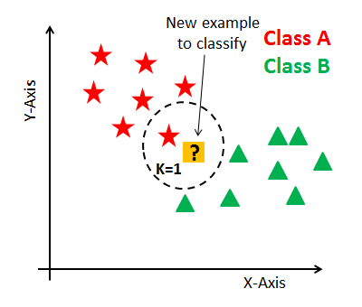
Our findings: KNN

Slide 16
Our findings: KNN
Variables Tested | Our Response Fit
All Variables Provided (Some Missing) | 86.2%
Average Cyclomatic Complexity | 72.8%
Average Number of External Blocks | 87.6%
Proprietary Code Count | 83.1%
Average Number of Inline Blocks | 80.9%
Number of DOM On-Event Handlers | 88.5%

Slide 17
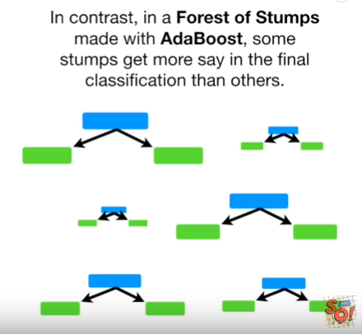
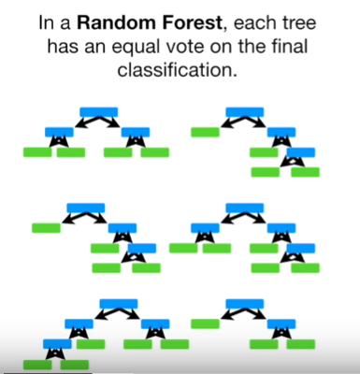
Our findings: Adaboost

Slide 18
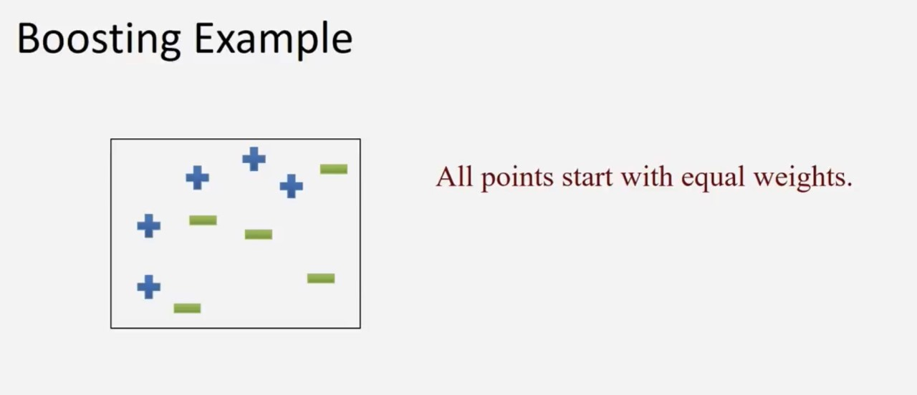
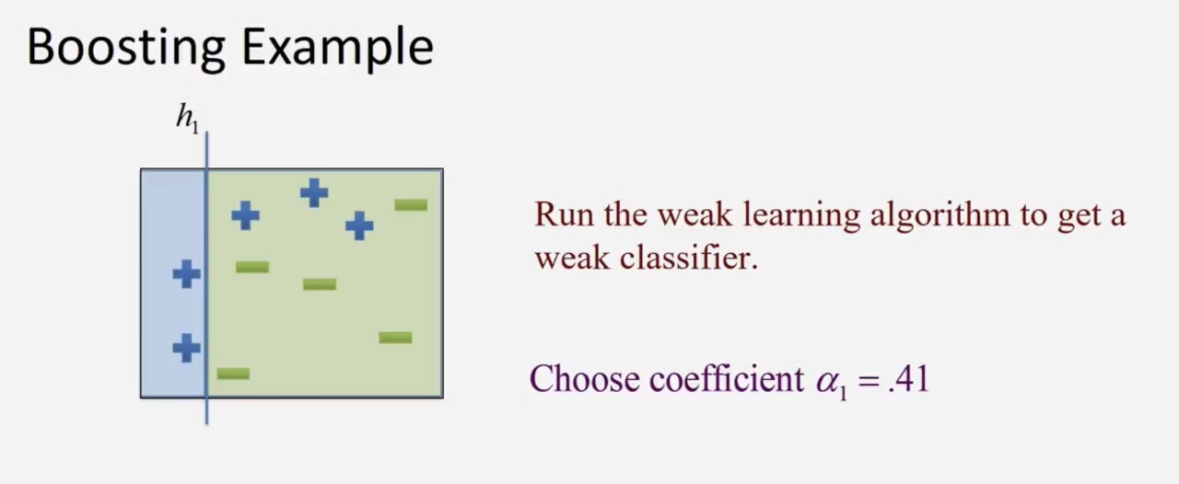
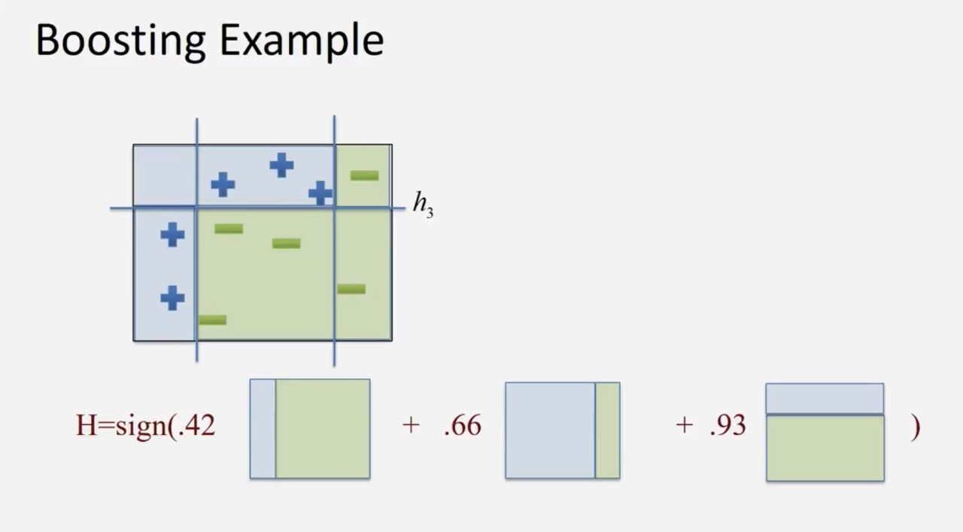
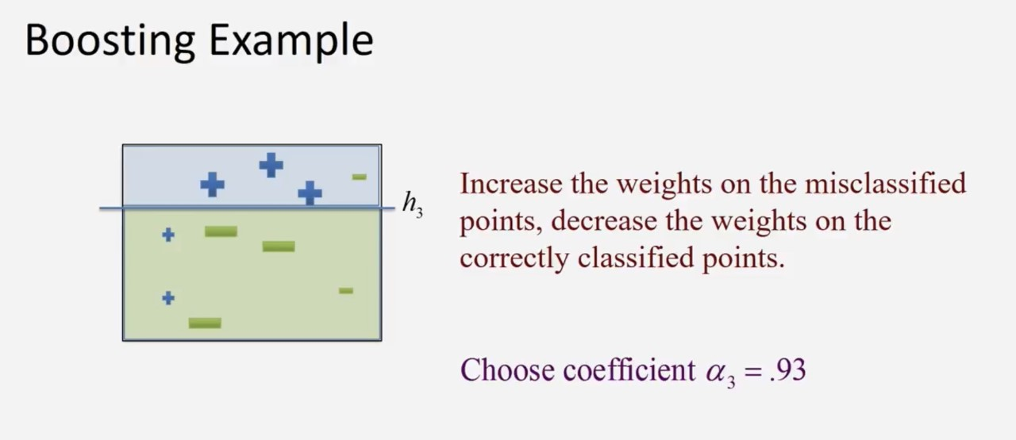
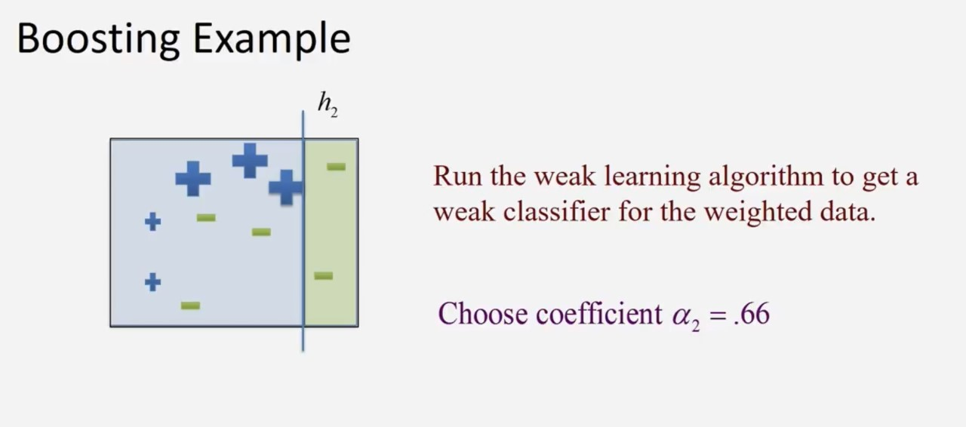
Our findings: Adaboost

Slide 19
Our findings: Adaboost
Variables Tested | Our Response Fit
All Variables Provided (Some Missing) | 86.97%
Average Cyclomatic Complexity | 82.28%
Average Number of External Blocks | 87.05%
Proprietary Code Count | 83.01%
Average Number of Inline Blocks | 83.64%
Number of DOM On-Event Handlers | 87.05%

Slide 20
Results Summary
Variables Tested | ADABOOST | KNN | Random Forest | CART
All Variables Provided (Some Missing) | 86.97% | 86.2% | 91.5% | 88.03%
Average Cyclomatic Complexity | 82.28% | 72.8% | 83.0% | 83.16%
Average Number of External Blocks | 87.05% | 87.6% | 88.3% | 72.47%
Proprietary Code Count | 83.01% | 83.1% | 82.6% | 83.20%
Average Number of Inline Blocks | 83.64% | 80.9% | 80.3% | 80.09%
Number of DOM On-Event Handlers | 87.05% | 88.5% | 83.2% | 86.91%
Different results for Box and Whisker Charts, but in the same general range.

Slide 21
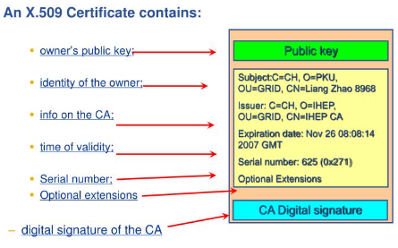
Next Step
Continue with analysis of certificate features.
Very important because directly ties to authentication.
Different than before because we have all variables.
Also have some of the raw data.
Problem: We do not know the results achieved by the authors.

Slide 22
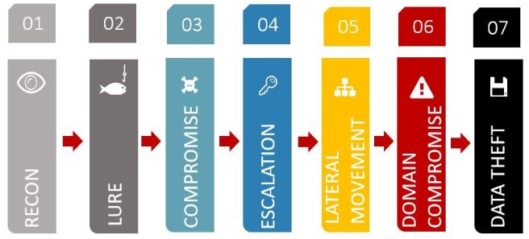
Cyber kill chain

Slide 23
Questions

Slide 24
Suggestions
XGBOOST and MLP (Multi-Layer Perceptron – in Sci-Kit Learn – neural nets)
Scale
Look at coefficients (collinearity – may can/need to get rid of certain variables)

Slide 25
Questions?

Slide 26
PhishMon: A Machine Learning Framework for Detecting Phishing Webpages
BY: Austin Willoughby, Jorge Vargas Amezcua, and John Tomaselli

Slide 27
Agenda
The Basics of Phishing Attempts
What Does Phishmon Do?
Their (Author’s) Findings
Our Situation
Provided Data
Our Findings
Questions

Slide 28
The basics of phishing attempts
Phishing is a social engineering technique used to gather sensitive information or unauthorized access to a user system via malicious email.
Considered a social engineering technique because direct user interaction is usually required to enable the malicious end state.
Most phishing attempts try to lure end users to click on a Uniform Resource Locator (URL) whose corresponding webpage is either laced with malicious code or that solicits end user information.
To bypass email filters, attackers will attempt to masquerade their malicious webpages as legitimate webpagess by:
Employing URLs that appear legitimate when compared to the wider population (HTTP Features).
Applying the same look and ‘feel’ as legitimate websites (Code Complexity).
Using certificates, or external validation of trustworthiness (Certificate Features).

Slide 29
What does PHISHMON do?
Phishmon is a, “scalable feature-rich machine learning framework for detecting unseen phishing attacks in a real-time fashion.” The author claim this is relatively unique because:
Phishmon is system independent (Not exlucsive to a particular tool suite).
Phishmon targets intrinsic features of phishing attacks and does not rely on specific heuristics of previous attacks.
Phishmon is language agnostic (Human language, not programming language).
Three set of targeted feature sets:
HTTP Features – Does the physical URL used vary from expected norms?
Code Complexity Features – How intricate and extensive is the employed code?
Certificate Features – Are the features associated with the webpage’s certificate expected?

